Slide 1
Introduction
to kill a mockingbird by harper lee

Slide 2
Contents
Historical Background
Characters
What to look for in chapters 1-4
to kill a mockingbird by harper lee

Slide 3
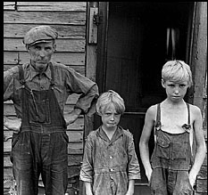
Historical Background
The setting
Maycomb, Georgia
1933-1935
Great Depression
Hitler in power in Germany
to kill a mockingbird by harper lee

Slide 4
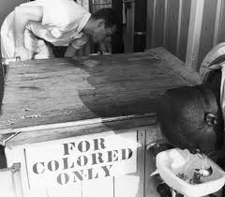
Historical Background
Slavery was abolished in 1864, but Southerners still believe in white supremacy.
Segregation exists. Blacks may not sit in the same sections as whites. They have separate facilities as well.
to kill a mockingbird by harper lee

Slide 5
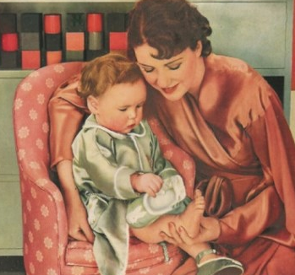
Historical Background
Gender Bias
Women were the weaker sex.
Education not important for women.
Wealthy women were expected to supervise staff
Men were not seen as nurturing
to kill a mockingbird by harper lee

Slide 6
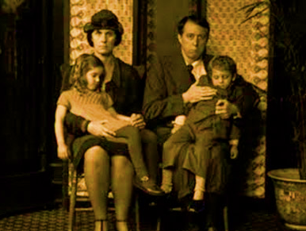
Historical Background
Poor White Families
Hard-working
Honest
Proud
Survive on very little
Always pay back their debts – even if it is with hickory nuts, turnips, or holly.
The Cunninghams fit this category
to kill a mockingbird by harper lee

Slide 7
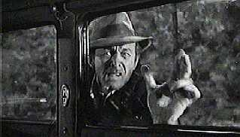
Historical Background
Poor white trash
Dirty
Lazy
Good-for-nothing
Never done a day’s work
Foul-mouthed
Dishonest
Immoral
The Ewells fit this category
to kill a mockingbird by harper lee

Slide 8
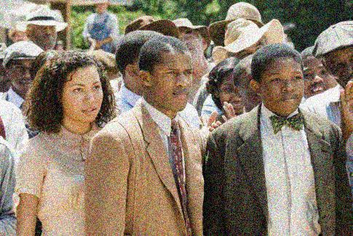
Historical Background
The Black Community
Simple
Honest
Clean
Hard-working
God fearing
Proud
Would never take anything with paying it back
Respectful
Had stronger character than most of the whites
Oppressed
Uneducated
Discriminated against
Talked about badly
Deserve better than what is dished out to them by society
to kill a mockingbird by harper lee

Slide 9
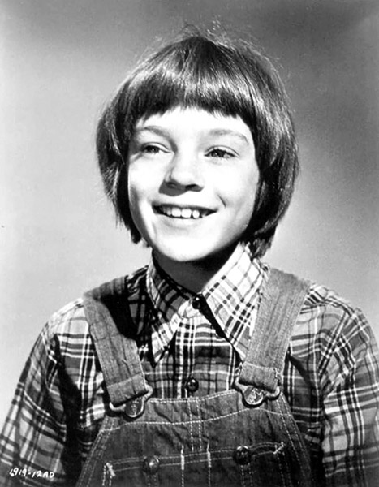
Characters Jean Louise Finch “Scout”
The story’s narrator
Although now an adult, Scout looks back at her childhood and tells of the momentous events and influential people of those years.
Scout is six when the story begins.
She is naturally curious about life.
to kill a mockingbird by harper lee

Slide 10
Characters Atticus Finch
Father of Scout and Jem
A widower
An attorney by profession
Highly respected
Good citizen
Instills good values and morals in his children.
to kill a mockingbird by harper lee

Slide 11
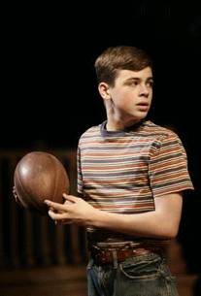
Characters Jem Finch
Scout’s older brother
Looks up to his father Atticus
Usually looks out for Scout
Typical older brother at times
Smart
Compassionate
Matures as the story progresses
to kill a mockingbird by harper lee

Slide 12
Characters Calpurnia
The Finch’s black housekeeper
Has watched the children since their mother’s death
Has been a positive influence on the children.
to kill a mockingbird by harper lee

Slide 13
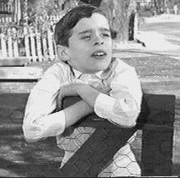
Characters Dill
A close friend of Jem and Scout
Usually lives in Maycomb only during the summer (stays with a relative)
Tells “big stories”
Has been deprived of love and affection
to kill a mockingbird by harper lee

Slide 14
Characters Tom Robinson
A young, harmless, innocent, hardworking black man
Has a crippled left hand
Married with three children. Works on a farm belonging to Mr. Link Deas, a white man
to kill a mockingbird by harper lee

Slide 15
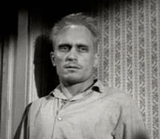
Characters Arthur “Boo” Radley
An enigma
An adult man, whose father has “sentenced” him to a lifetime confinement to their house because of some mischief he got into when he was a teenager.
Has a reputation of being a lunatic
Basically a harmless, well-meaning person
Sometimes childlike in behavior
Starving for love and affection
to kill a mockingbird by harper lee

Slide 16
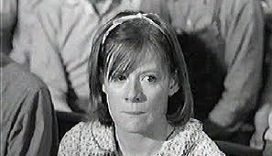
Characters Mayella Ewell
The oldest child of Bob Ewell
Shy
Lonely
to kill a mockingbird by harper lee

Slide 17
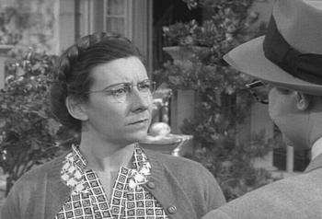
Characters Miss Maudie Atkinson
Scout’s Neighbor
Loves gardens and bakes the best cake in Maycomb
Knows how to treat children like adults
to kill a mockingbird by harper lee

Slide 18
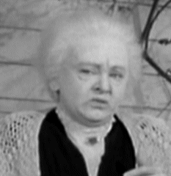
Characters Mrs. Henry Lafayette Dubose
A mean old woman in the Finch neighborhood
Teaches the children a lesson in bravery
to kill a mockingbird by harper lee

Slide 19
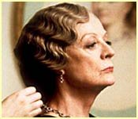
Characters Aunt Alexandra
Atticus’s sister
Wants Scout to be a lady
Wants Jem to be a gentleman
to kill a mockingbird by harper lee

Slide 20
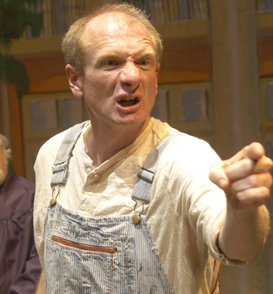
Characters Bob Ewell
Mayella’s poor white trash father
The town parasite who lives off the town’s bounty
to kill a mockingbird by harper lee

Slide 21
Characters Heck Tate
The town sheriff
to kill a mockingbird by harper lee

Slide 22
What to Look For in Chapters 1-4
Scout | Jem | Dill
Atticus | Calpurnia | Boo Radley
Walter Cunningham | Rachel | Caroline Fisher
Burris Ewell | Gum | Hot Steam
Molasses | Cootie | Read

